Slide 1


Slide 2
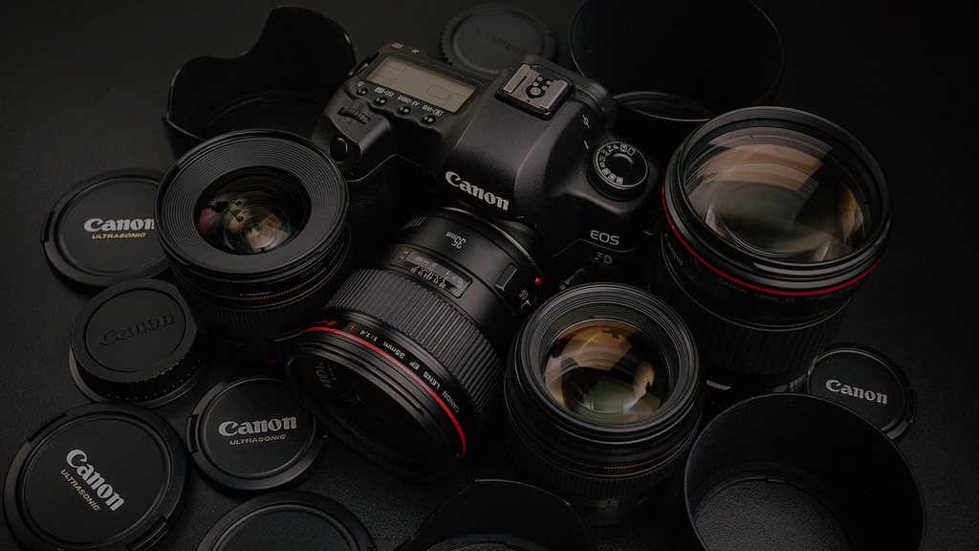

RECOMMENDATION ENGINE
FOR CAMERA RENTAL SERVICES (KLACHAK)
Group Seven
Notes:
To use this title animation slide with a new image simply 1) move the top semi-transparent shape to the side, 2) delete placeholder image, 3) click on the picture icon to add a new picture, 4) Move semi-transparent shape back to original position, 5) Update text on slide.

Slide 3
Klachak
Our mission
Photography accessible to all sincere enthusiasts.
@ affordable price.
Ganesh Sidhamalli
Kalchak - CEO

Slide 4
Klachak
Purpose - Opportunity Statement
Objective
Primary Objective is to build Recommendation Engine.
EDA
Exploratory Data Analysis to produce Key findings and Dashboards
Solution
Recommender System as a Service

Slide 5



Klachak
Approach
Prepare & Explore
Model Building
Implementation

Slide 6
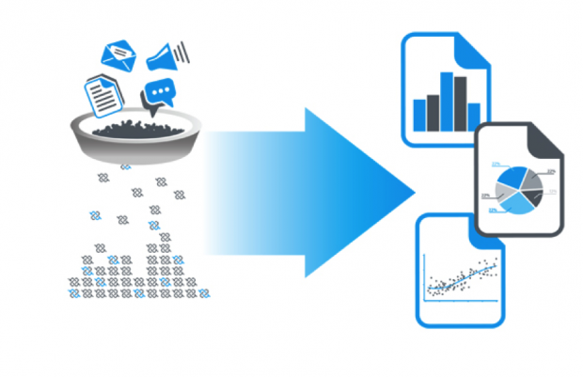
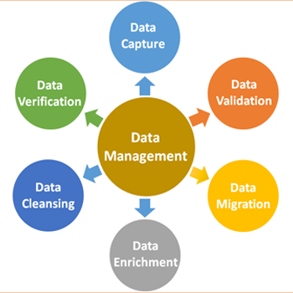

Klachak
Prepare and Explore
Data Gathering
Data Preparation
Data Cleansing
Standardization
Trends
Behaviour
Cohort

Slide 7
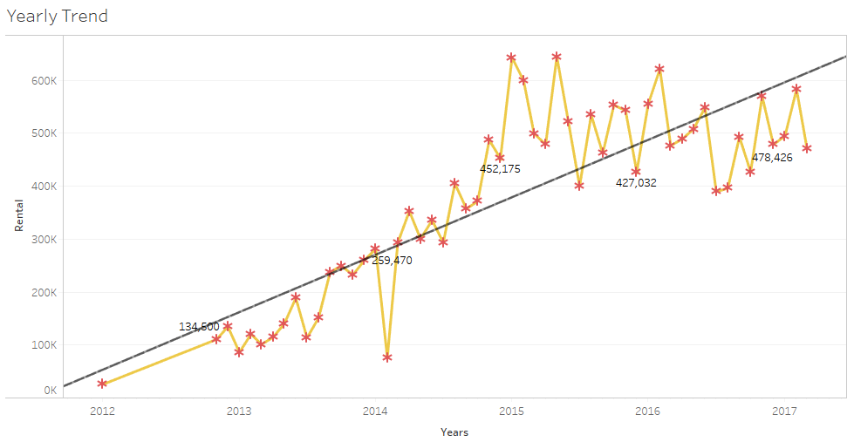
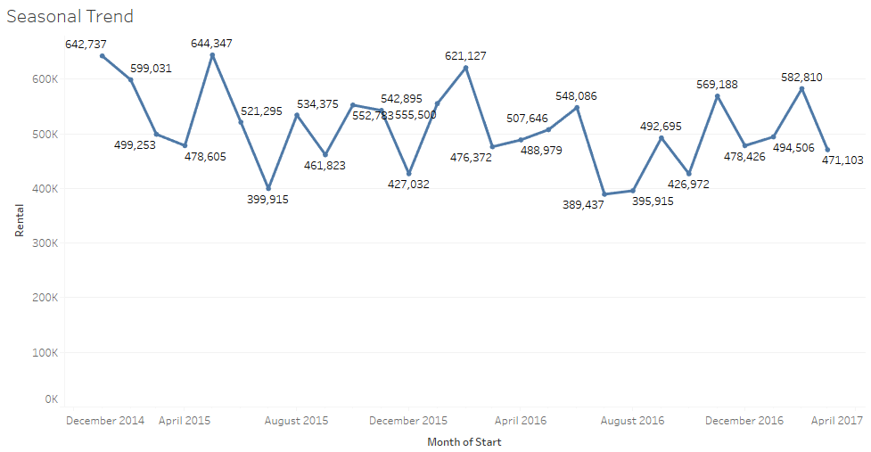
Klachak
Sales & Seasonal Trends
Rentals shows increasing trend whereas we see seasonality only for the last two years.
Three seasonal peaks per year in the months as January/February, July/August and October/November.

Slide 8
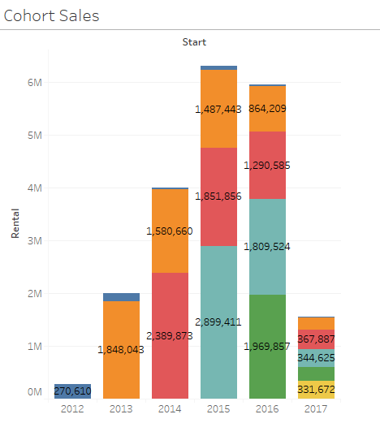
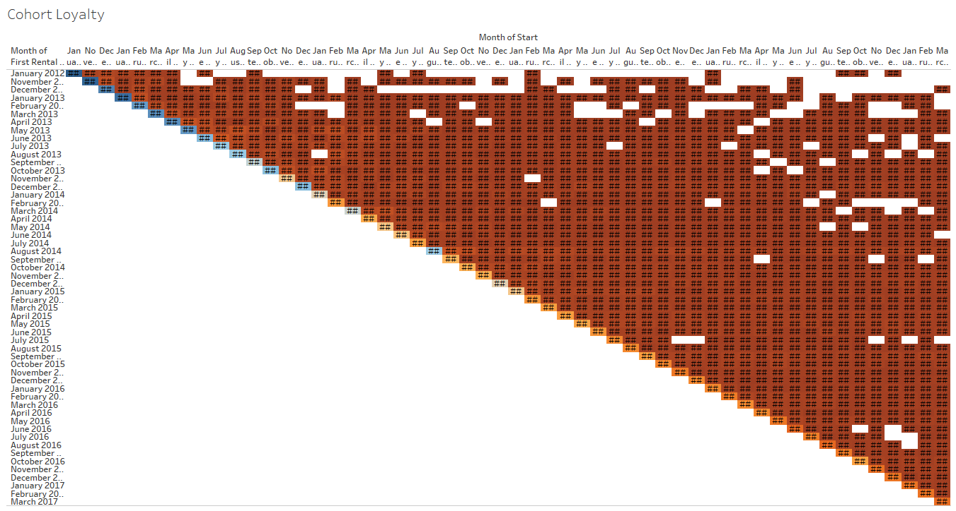
Klachak
Cohort
Customer who rented in 2013 or 2014 rented frequently are most loyal ones.
Customers of Klachaks always stays as customer because of the value .
Net Adds in the last two years is reducing compared to initial years.

Slide 9
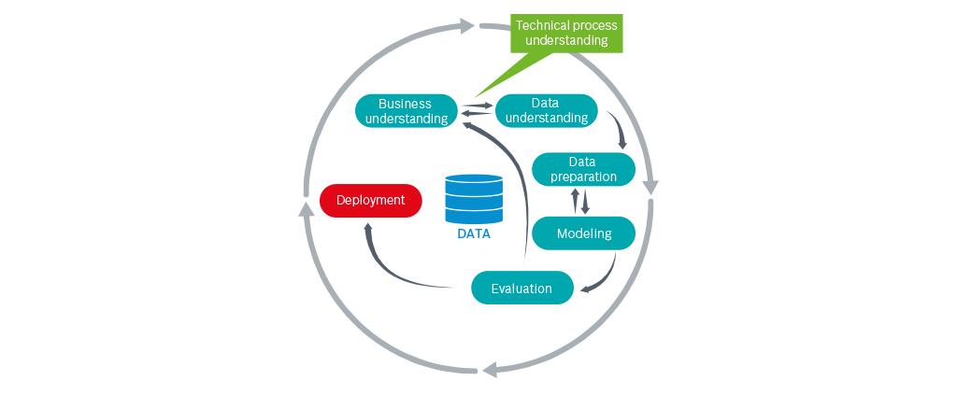
Model Building
Klachak

Slide 10

Sales Data
TRANSACTIONS
Customer -> Product
UNDERSTAND & SCORE HOW CUSTOMER LIKES EACH PRODUCT
Weighted Probability
Customer Segmentation
RATINGS
From Rating, We Know,
User’s Liking and Preferences
Product Similarities w.r.t Rating
Profiling
RFM
Weighted Probability
RATINGS

Slide 11




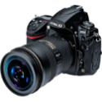
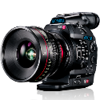
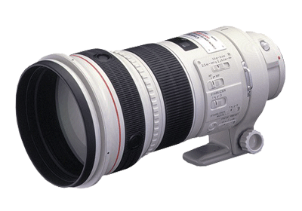
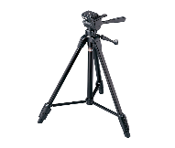
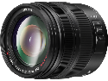
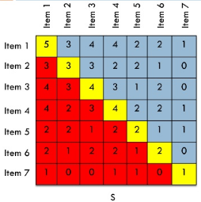
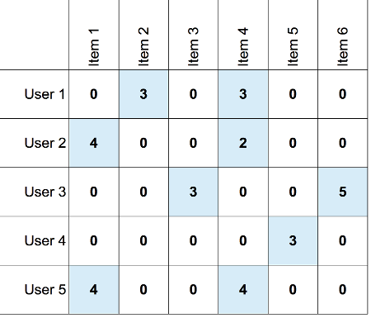
ITEM BASED COLLABORATIVE FILTERING
B
C
D
A
1
2
3
4
5
Highly Sparse Data
2%
PREDICT
RATING
&
RECOMEND
Large Scale Data
165 X 3513
[USER] X [ITEM]
[ITEM] X [ITEM]
COSINE
SIMILARITY
Serendipity

Slide 12
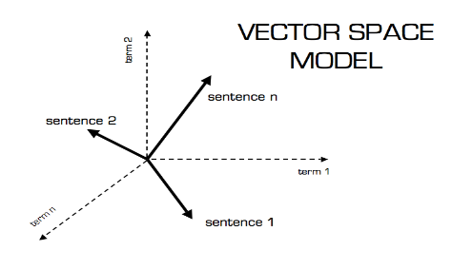

Klachak
Content Based Recommendation
dpreview.com
Unigram Bigram Trigram
Product Attributes
(Name)
TF - IDF
Cosine Similarity
Cannon EF 70-200mm f/2.8L IS USM
Brand | Type | Focal Length | F-stop | IS | USM
Cannon | EF | 70-200mm | 2.8L | Yes | Yes
---
---
---
:
----
Product Recommendations
Notes:
Tip:
When using complex image as full-bleed background add a transparency (70%-90%) fill layer to give contrast to text.

Slide 13

Klachak
Hybrid Recommendation
30%
70%
Notes:
Tip:
When using complex image as full-bleed background add a transparency (70%-90%) fill layer to give contrast to text.

Slide 14
Klachak
Model Building
1
2
3
4
5
RFM
Item Based Collaborative Filtering
Content Based Recommendation
Hybrid Recommender System
Model Evaluation
Reference : The basics you can find anywhere 5 Steps To Successful Storytelling Published on April 5, 2014 Featured in: Marketing & Advertising

Slide 15
Klachak
Model Evaluation
Training Data : 70%
Test Data : 30%

Slide 16
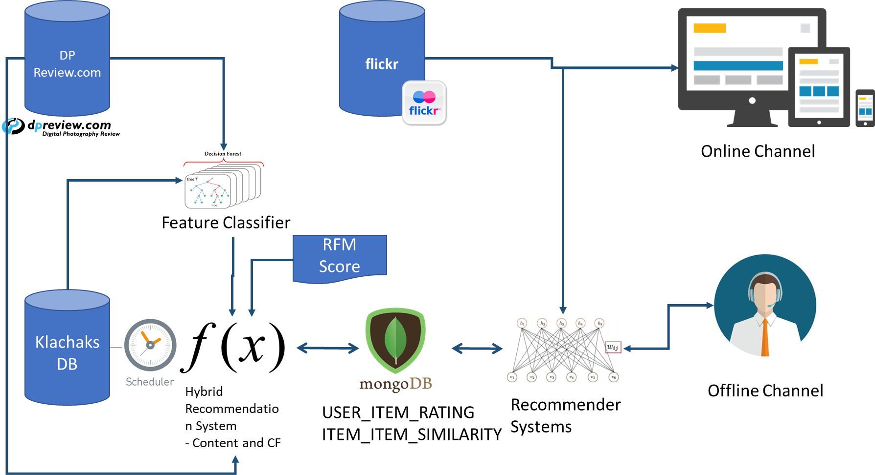
Implementation
Klachak

Slide 17
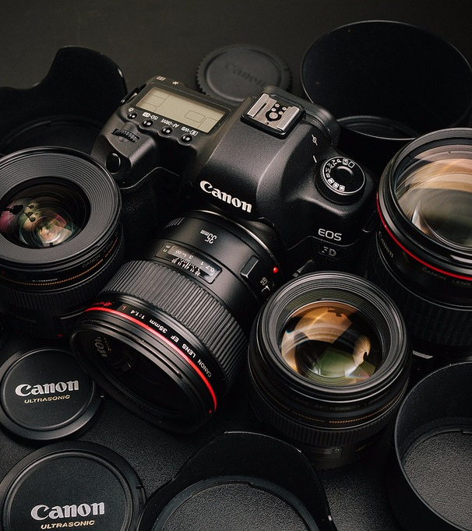
TAKEAWAY
Recommendation as a Solution
INSPIRE
As a service to Digital Sales Improvement
ACTION
Integrate Customer Rating to Model
Notes:
Combine an image and multiple key statements with a strong grid.

Slide 18
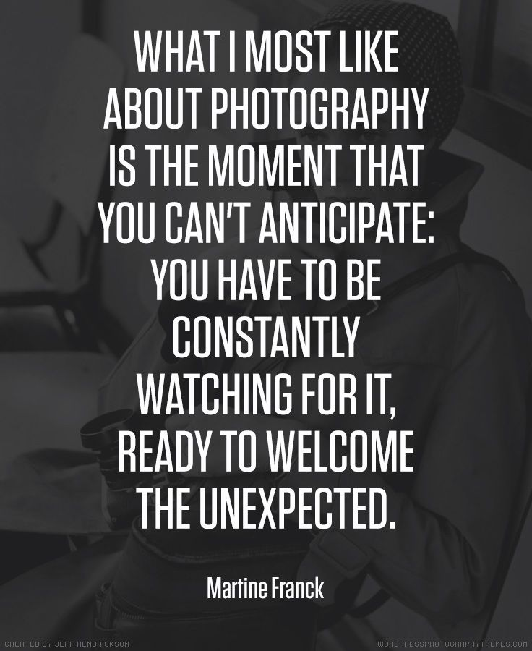
Thank You

